Slide 1
UBC | Faculty of Education
in partnership with JIBC
MEd in Adult Learning & Education
Offering Department: Educational Studies
Support unit: Professional Development &Community Engagement
Notes:
You may choose to replace this image with the primary cohort image used for promoting your program. To do so, go to View > Slide Master to access the master version of this PPT file.

Slide 3
agenda
Introductions
UBC, Faculty of Education & Educational Studies
MEd Adult Learning & Education Program
Admissions & Application Procedures/Requirements
Questions

Slide 4
UBC, Faculty of Education & Educational studies

Slide 5
The university of british columbia
The University of British Columbia is a global centre for research and teaching, consistently ranked among the top 20 public universities in the world.
UBC boasts robust student populations at its two campuses at both the graduate and undergraduate level.
Students | Vancouver | Okanagan | Total
Undergraduate | 44,882 | 8,990 | 53,872
Graduate | 9,981 | 945 | 10,926
Totals | 54,863 | 9,935 | 64,798

Slide 6
The faculty of education
UBC’s Faculty of Education has over 160 faculty members representing many disciplines and consists of four key academic departments:
Department of Educational Studies
Department of Curriculum & Pedagogy
Department of Educational & Counselling Psychology
Department of Language & Literacy Education
The Faculty also has a School of Kinesiology, a variety of academic and administrative units, and research centres and institutes, including:
Indigenous Education Office
Teacher Education Office
International Office
Office of Research in Education

Slide 7
The department of educational studies
The Department of Educational Studies (EDST) is headed up by Professor Mona Gleason. EDST is a multi-disciplinary community of scholars who share an overarching interest in questions of equity and social justice in education. EDST approaches a range of questions in education from various disciplinary lenses, among them:
Sociology
History
Philosophy
Cultural studies
Critical pedagogy
Amidst our diversity, we share a commitment to scholarly research that expands our understanding of education’s social justice, global influence and transformational potential.

Slide 8
educational studies at a glance
The Department of Educational Studies is comprised of:
33 Faculty members
5 Support staff
350 Graduate students
9 programs, including MEd, MA, EdD and PhD programs, and key contributions to the Faculty of Education’s Teacher Education (BEd) program.
4 Concentrations/Area Groups:
Adult Learning & Education (ALE/ALGC)
Educational Administration & Leadership (EDAL)
Higher Education (HIED)
Society, Culture & Politics in Education (SCPE)

Slide 9
Program Overview: MEd in adult learning & education
Credential: Master of Education (MEd)
Credits: 30
Mode: Blended: mix of face-to-face sessions with some web-based interaction
The Adult Learning and Education (ALE) program is the oldest graduate adult education program in Canada with historical roots in traditions of social welfare, community development and extension education.
ALE is concerned with the development of scholars and practitioners who will shape society in ways that promote lifelong learning for all. Our ALE program challenges students to understand the diverse contexts in which adult learning occurs and their role in these from a wide variety of theoretical, conceptual and philosophical perspectives.

Slide 10
Program participants
The MEd program is a professional degree for people who wish to enhance their knowledge and skills as practitioners in any adult education setting.
We welcome students from a wide variety of backgrounds and diverse sites of practice including: community development, higher education, adult basic education, ESL, social movements, business, and international development.
Students bring diverse interests in how adult learning and education contributes to many areas of concern including: health education, gender and women’s learning, social activism, online learning, workplace learning, intercultural and multicultural issues, anti-oppression, program planning, adult literacy, English as an Additional Language, environmentalism, and internationalization.

Slide 11
Program structure
MEd students take three core courses, one research methods course and several electives which can include courses in other departments and faculties.
Students have the option of completing the program with 30 credits of coursework or completing 27 credits of course work plus a graduating paper/project focused on an issue or concern in their field of practice.
The core courses are:
EDST 503: Historical and Philosophical Foundations of Adult Learning and Education
EDST 514: Adult Education Program Planning Theory
EDST 518: Theory and Research on Adult Learning
Research methods course: either EDUC 500 or another approved methodology course.

Slide 12
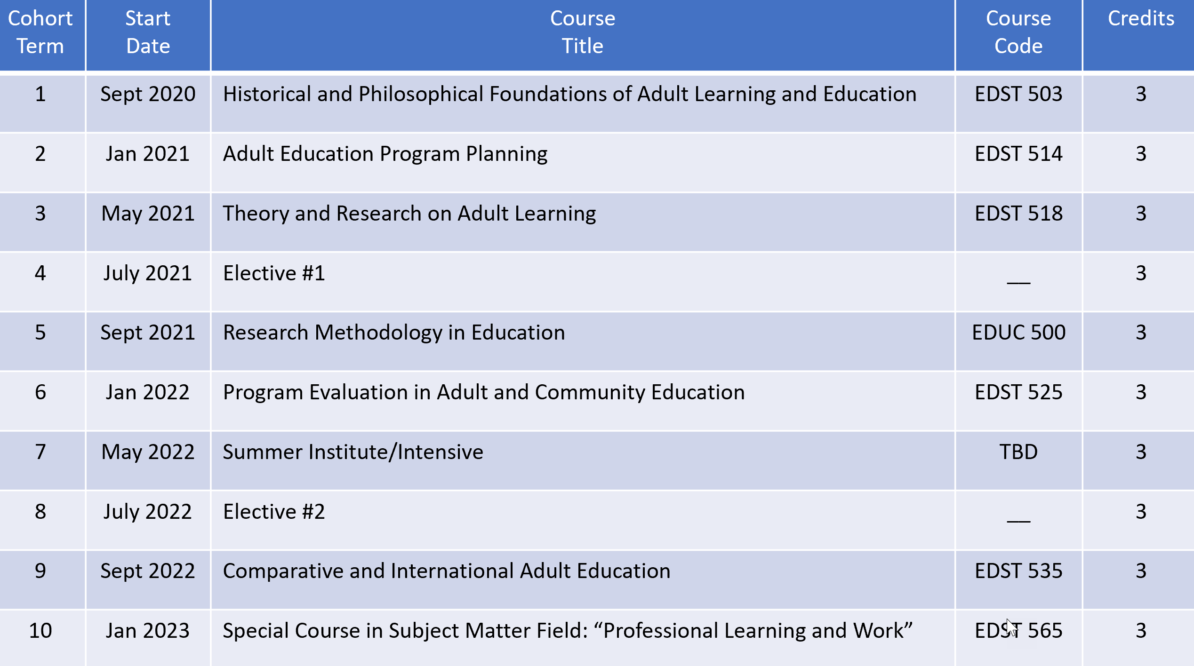
Proposed schedule for ALE1/JIBC cohort

Slide 13
program Electives & Graduating paper
Electives: There is some flexibility in choosing electives; students must consult with their advisor before pursuing electives. Elective courses can include other ALE courses as well as courses in other EDST programs, other Faculty of Education departments, and other UBC departments and faculties.
Electives can also include a self-directed reading course (EDST 580) and a practicum course (EDST 561). Up to 6 credits can be taken in 300- or 400-level undergraduate courses.
Graduating Paper: Students who wish to complete a 3-credit Graduating Paper (EDST 590) should consult with their advisor. Graduating papers are an opportunity to undertake an in-depth exploration of an issue, one that might be related to the student’s area of practice. The paper can take many forms such as an extended essay that includes a thorough review of relevant literature, a policy framework, a program syllabus or curriculum, or other materials developed by the student that are immediately useful for their area of practice or work. The length of written papers varies and depends on the topic but is often 40-50 pages.

Slide 14
Admissions &
Application Information
Linda HAFTNER, Senior program Assistant
Professional Development & Community Engagement (PDCE)

Slide 15
Admissions requirements
4-year undergraduate degree
B+ range (76% at UBC) in all senior-level courses or
B- range (68%) with a combined 4 year undergraduate degree plus a BEd
Special cases for lower GPA
Alternatively, applicants who do not meet the requirements stated above, but who have had other significant formal training, relevant professional experience, and/or otherwise possess demonstrable knowledge or expertise that would prepare them adequately for successful study in a specific graduate program, may be granted admission on the recommendation of the appropriate graduate program and approval of the Dean of the Faculty of Graduate and Postdoctoral Studies.

Slide 16
Admissions requirements (continued)
2 years teaching (or equivalent experience)
A minimum of two years full-time teaching experience or an equivalent combination of engagement within schools, communities, non-governmental organizations, or other education-oriented environments.
Satisfy the English Language Requirement
Applicants from a university outside Canada in which English is not the primary language of instruction must provide results of an English language proficiency examination as part of their application. Tests must have been taken within the last 24 months at the time of submission of your application.

Slide 17
ENGLISH LANGUAGE REQUIREMENTS
TOEFL
Score 580 or higher (paper-based)
237 or higher (computer-based)
92 or higher (internet-based) with a minimum 22 on each component
IELTS
Minimum overall band score 7
No component less than 6.5
If this applies to you, please contact me.

Slide 18
Application requirements – SUPPORTING DOCUMENTS
Two (2) sealed transcripts from ALL post-secondary institutions attended with the exception of UBC. (Front & back in a single PDF file)
Resumé
600-word statement of intent: A 600-word statement of intent clearly outlining your experiences and interests in the program. Specify your interest in this program and outline how the specialization in Adult Learning & Education supports your professional goals.
Three letters of recommendation: from educators, supervisors, colleagues, or clients who can speak to your engagement with this subject matter, your ability to complete a graduate degree, and other relevant professional experience.
Writing sample: Any piece of writing you have done for a course, a work project, or a professional publication that demonstrates your ability to write clearly.

Slide 19
Application Procedures
grad.ubc.ca/apply/online
Program Search: select “ALE1” (September 2020 intake)
Upload all supporting documents

Slide 20
Application Deadlines
Online application is now open
DEADLINE: March 31, 2020 (includes all supporting documents)
Application fee
$104.00CAD for domestic applicants
$168.25CAD for international applicants

Slide 21
Tuition
Program tuition cost:
Canadian Students: $15,140.96 CDN & International Students: $15,437.84 + student fees (Student fees vary each term)
Installments: Tuition is paid in 8 installments (September, January and May):
Canadian Students: $1,892.62 CDN & International Students: $1,929.73 CDN
Subject to increase in May - First installment due the first week of September
Payment methods: Bank transfer, cheque, money order or credit card
Tuition is charged as a whole program fee, not on a per-credit basis

Slide 22
Program Assistant information
Linda Haftner, Senior Program Assistant
Phone: 604-822-4499
Toll Free: 1-888-492-1122
Fax: 604-822-2015
linda.haftner@ubc.ca

Slide 24
Questions & Answers

Slide 25
For further information
Tom Sork, Professor & Cohort Advisor, Educational Studies/ALE
tom.sork@ubc.ca
Linda Haftner, Senior Program Assistant, PDCE
linda.haftner@ubc.ca
604-822-4499
Program website: https://pdce.educ.ubc.ca/med_jibc/

